Slide 1
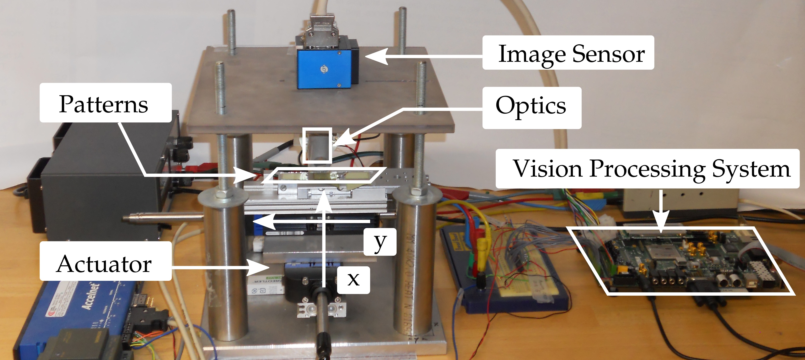
Cross-domain Modeling and Optimization of High-speed Visual Servo Systems
Zhenyu Ye, Eindhoven University of Technology and Connecterra BV
Henk Corporaal, Eindhoven University of Technology
Pieter Jonker, Delft University of Technology
Henk Nijmeijer, Eindhoven University of Technology

Slide 2
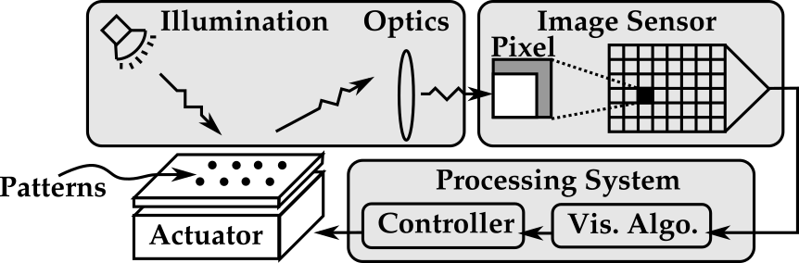
Visual Servo Systems: a Multi-domain View
    Focus: controlled and structured environments.
Notes:
First, define visual servo system: using visual feedback directly for motion control
A simple example: walk through the domains, from illumination to actuator.

Slide 3
Challenges and Proposed Solutions
  Challenge 1
    Limitations of visual feedback: low sample rate, large delay, coarse quantization.
  Proposed solution:
  Design template for high-speed vision processing.
    Challenge 2
    Cross-domain couplings and trade-offs.
    Proposed solution:
    A framework of methods for cross-domain modeling and optimization.
Notes:
Even for a simple visual servo system, challenges remain.
First: Sample rate, latency, and quantization.
Note on ref: P. I. Corke and M. C. Good, "Dynamic effects in visual closed-loop systems," in IEEE Transactions on Robotics and Automation, vol. 12, no. 5, pp. 671-683, Oct. 1996.
Proposed solution: a design template for parallel processing.
Second: Cross-domain coupling and trade-offs.
Proposed solution: cross-domain modeling and optimization methodology.

Slide 4


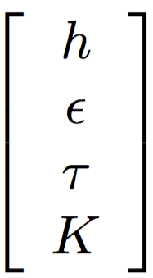
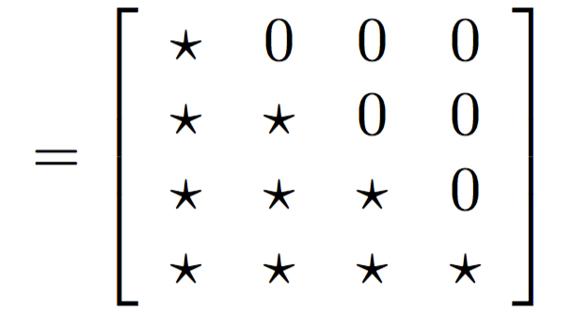
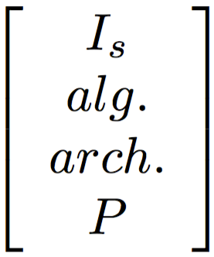
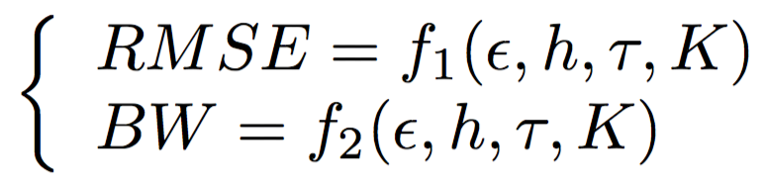
Axiomatic Design: an Example
Dependent
Parameters
Design
Matrix
Design
Parameters
: Dependence
: Independence
Sample period
Image sensor
Quantization error
Vision algorithm
Delay
Processing architecture
Controller
Plant
Performance criteria
Precision
Bandwidth
N. P. Suh, “Axiomatic design theory for systems,” Research in Engineering Design, vol. 10, no. 4, pp. 189–209, 1998.
Notes:
This paper uses the axiomatic design method
It starts with design parameters. They are parameters that a designer can tune and optimize.
Here are example of design parameters in four domains. Walk over.
[click] By tuning these design parameters, we can obtain different sample period, etc. We can them dependent parameters.
[click] The dependency between them are specified by the design matrix. The matrix has two symbols, representing dependence and independence between the elements in those two vectors.
Example: Sample period only depends on image sensor, not vision algorithm, processing architecture, and actuator.
[click] One step further, the dependent parameters can be linked to multiple performance criteria.
The first question is how to obtain the design matrix.
The design matrix can be obtained by using a specific design template

Slide 5
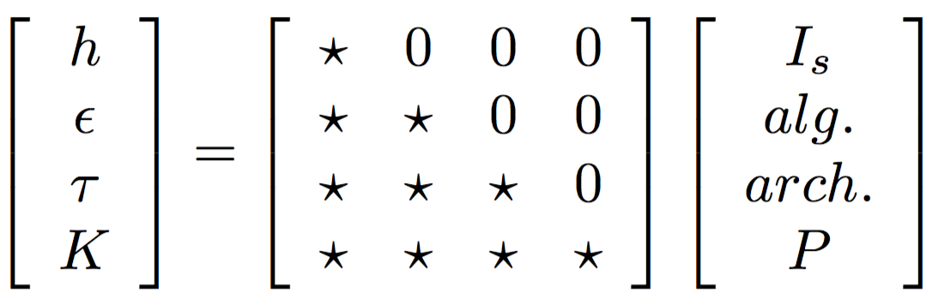
Design Matrix Obtained by Design Template
Sample period
Image sensor
Quantization error
Vision algorithm
Delay
Processing architecture
Controller
Plant
Time
Sensor
Readout
Processing
Stage 1
Processing
Stage 2
Frame 1
Processing
Sample Period
Sensor
Readout
Processing
Stage 1
Processing
Stage 2
Frame 2
Image frame
Notes:
A certain coupling pattern in the design matrix can be obtained by using a specific design template.
For example, the sample period can be made only depend on image sensor, not on vision processing.
How do we make that happen? The design template for it can look like this.
We start by read out the image from the sensor, and then followed by processing.
We can pipeline the vision processing into multiple stages.
Such that each processing stage takes less time than image readout.
We can start read out the second frame while still processing the first frame
By doing that, we can set the sample period equal to sensor readout time.
The other coupling patterns in the design matrix can be achieved similarly.

Slide 6
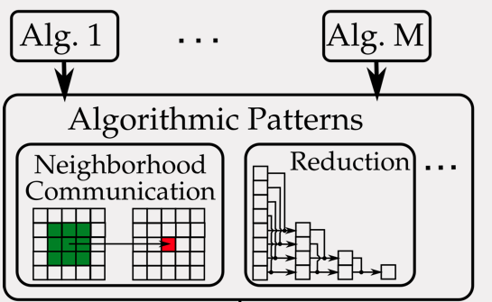
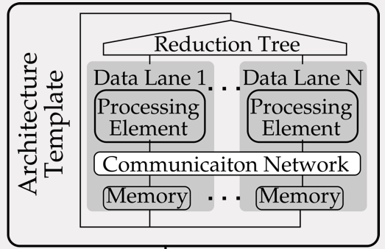
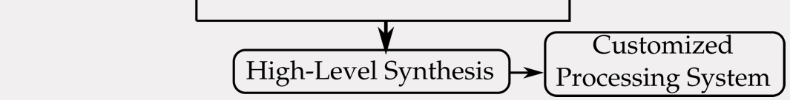
Delay: Coupling of Algorithm and Architecture
  Approach:
  (1) algorithmic patterns
  (2) architecture template
  (3) high-level synthesis
Delay of Vision Processing
Notes:
Next, delay, which is more complicated.
It depends on both vision algorithm and processing architecture.
The solution contains three parts.
First part is algorithmic patterns, which are data access patterns of algorithms, such as neighborhood communication, and reduction.
After that, we can define an architecture template that supports these algorithmic patterns.
We can use high-level synthesis to quickly generated the processing systems.
And then we can obtain the delay of the system for different design choices.

Slide 7
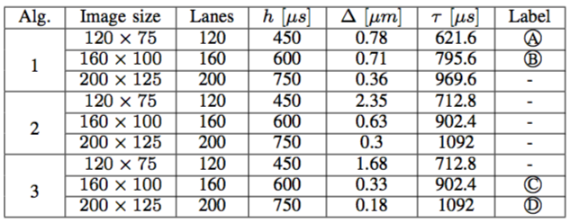
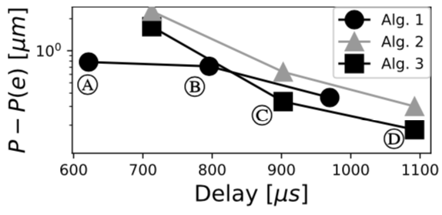
Case Study
3 image sensor sizes
3 configurations of architecture
3 vision
algorithms
Increasing quantization
(A)(B)(C)(D) are Pareto-optimal configurations
Increasing delay
Notes:
The proposed methods can be used to different use cases, and here is a case study.
The case study has different choices of image sizes, vision algorithms, and configuration of processing architecture
[click] By playing with these design options, we can obtain interesting trade-offs.
One example is the trade-off between measurement error and delay.
What does it mean? It means some algorithms are fast but not accurate. Some algorithms are accurate but slow.
And there are options in between. We have 4 configurations here.
The question is, which configuration is the best?
The answer is, it depends. It depends on the performance criteria. (It also depends on mechanical parameters of the plant, but skipped in this talk.)

Slide 8
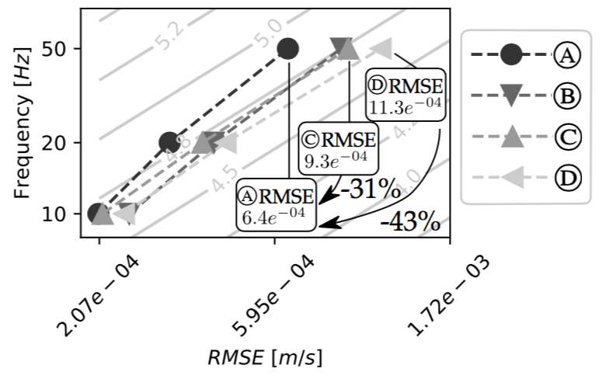

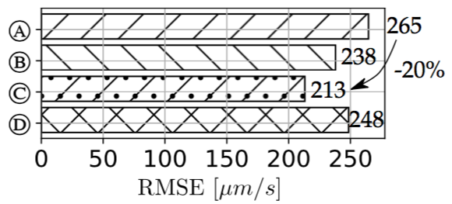

Performance After
Controller Optimization
Motion Error
Vision Error
(a) Precision
(b) Bandwidth
(a) Precision
(b) Bandwidth
Root-Mean-Squared-Error (RMSE)
of tracking a constant reference
Error of tracking sinusoidal signals
of different frequencies
Increasing reference frequency
Increasing tracking error
Increasing tracking error
Notes:
We have two different performance criteria here, which are: precision and bandwidth.
To clarify: so far, we have discussed quantization errors introduced by visual feedback. Now we would like to derive the motion errors when tracking a reference signal.
[click] First precision. Precision is defined as the root-mean-squared-error of tracking a constant reference.
Walk over the axis. Vertical axis has 4 configurations we shown earlier. Horizontal axis is the tracking error, increasing from left to right.
Configuration (C) has the smallest tracking error, and therefore is the best in terms of accuracy.
[click] Next, bandwidth. The bandwidth is measured by the error of tracking sinusoidal signals.
On the vertical axis, we have sinusoidal reference signal of different frequency.
For example, we have a 50Hz sinusoidal signal as reference. It is a fast signal to track.
The horizontal axis is the tracking error, again increasing from left to right.
Configuration (A) has the smallest tracking error. Therefore it is the best configuration for tracking such a fast changing signal.
Going back to the question, which configuration is the best.
Indeed, the answer is, it depends. The answer changes depending on the performance criteria.
And, we need cross-domain modelling and optimizations to answer the question.

Slide 9
Conclusions
    Cross-domain modeling and optimization are necessary. Demonstrated improvement:
      20% for tracking a constant reference.
      43% for high-bandwidth applications.
    The demonstrated improvements are only achievable by cross-domain modeling and optimization.
    This paper provides effective methods for such a purpose.
Thank you.
Notes:
So, what have we learned?
[click] First, Cross-domain modelling and optimization are necessary.
Because it provides a huge improvement in performance, for different use cases.
[click] Second, these improvements can only be achieved by cross-domain modelling and optimization.
[click] Third, this paper provides an effective framework for exactly such a purpose.
[click] Thank you.

Slide 10
Backup Slides

Slide 11
Visual Servo Systems: a Multi-domain View
    Focus on high-speed visual servo systems in structured environments.
    Require little adaptability. Predefined patterns are often used.
    Typically optimized for accuracy and bandwidth.
Notes:
First, define visual servo system: using visual feedback directly for motion control
A simple example: walk through the domains, from illumination to actuator.
Focuses on a specific use case: high-speed vision, structured environment.
As a consequence: emphasis on operation efficiency, require little adaptivity.

Slide 12
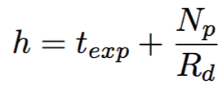

Modeling Sample Period and Measurement Error
Exposure
time
Number
of pixels
Quantization
function
Sample
period
Measurement
error
Rate of readout
Sensitivity
Notes:
Here are examples of modeling sample period and measurement error
[click] The sample period can be modeled as simple as exposure plus image read out.
[click] The measurement error can be modelled as a quantization function with sensitivity.
The sensitivity can be obtained by simulation. Details in the paper.
More complicated models can be used.

Slide 13
Modeling Measurement Error
Sample period
Image sensor
Quantization error
Vision algorithm
Delay
Processing architecture
Controller
Plant
Quantization function
Quantization error
Position of
image frame
sensitivity
Notes:
Here is an example of modeling measurement error
[click] The measurement error can be modelled as a quantization function with sensitivity.
The sensitivity can be obtained by simulation or experiment, depending on the use case.
More complicated models can be used.

Slide 14
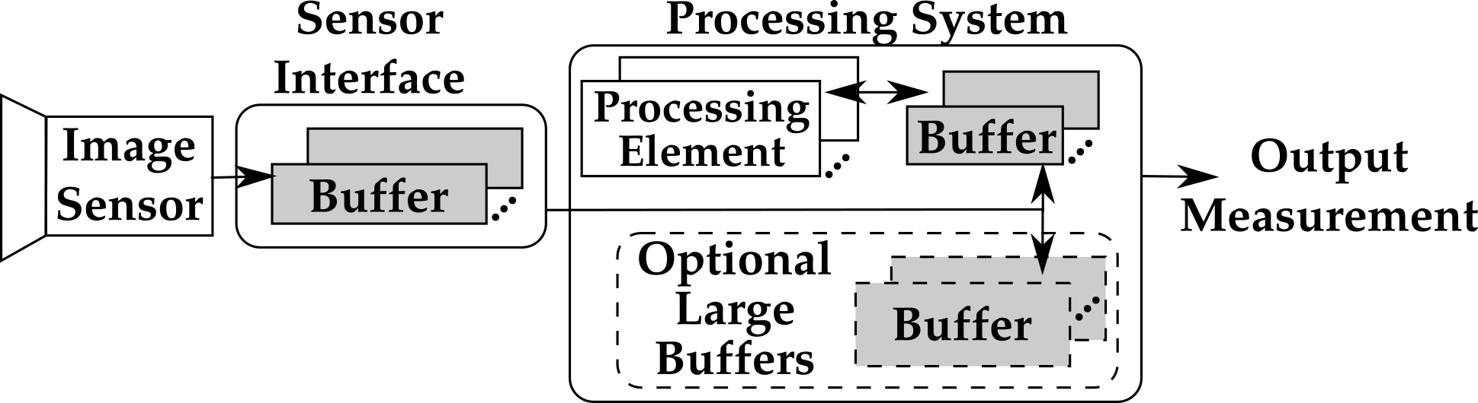
Design Template of High-speed Vision Systems
Pipelining processing in multiple stages
Decoupling sensor
readout from processing
Optional large buffer for multi-frame algo.
Notes:
First, a design template for high-speed vision systems.
Emphasis: multiple buffers for pipelined processing
Purpose: achieve a high sample rate, and decouple sample rate from processing.
Will be explained next.

Slide 15
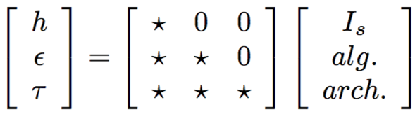
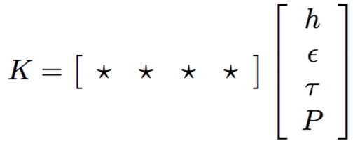
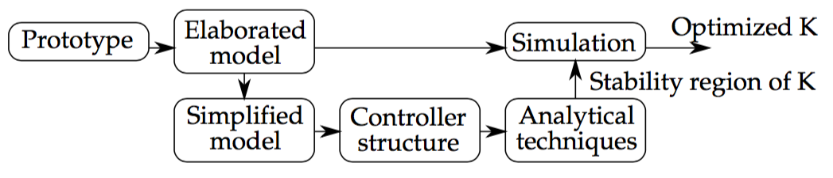
Controller Gain
Simplify dependency
of K
Optimizing K: analytical method and simulaiton
Notes:
In the end, we need to optimized controller gains, which depends on all design parameters.
However, the dependency can be reduced.
[click] By breaking down the design matrix.
[click] After that, a combination of analytical and simulation techniques can be used to optimize controller gain.

Slide 16
Controller Gain
Simplify dependency
of K
Notes:
In the end, we need to optimized controller gains, which depends on all design parameters.
However, the dependency can be reduced.
[click] By breaking down the design matrix.
[click] After that, a combination of analytical and simulation techniques can be used to optimize controller gain.

Slide 17
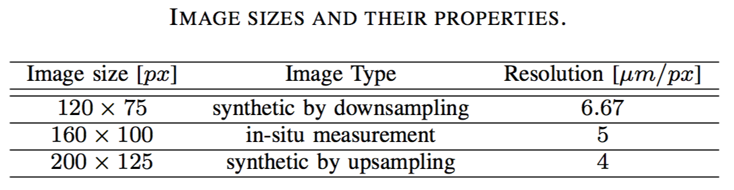
Image Sensors

Slide 18
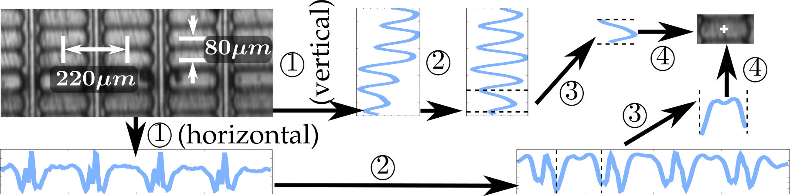
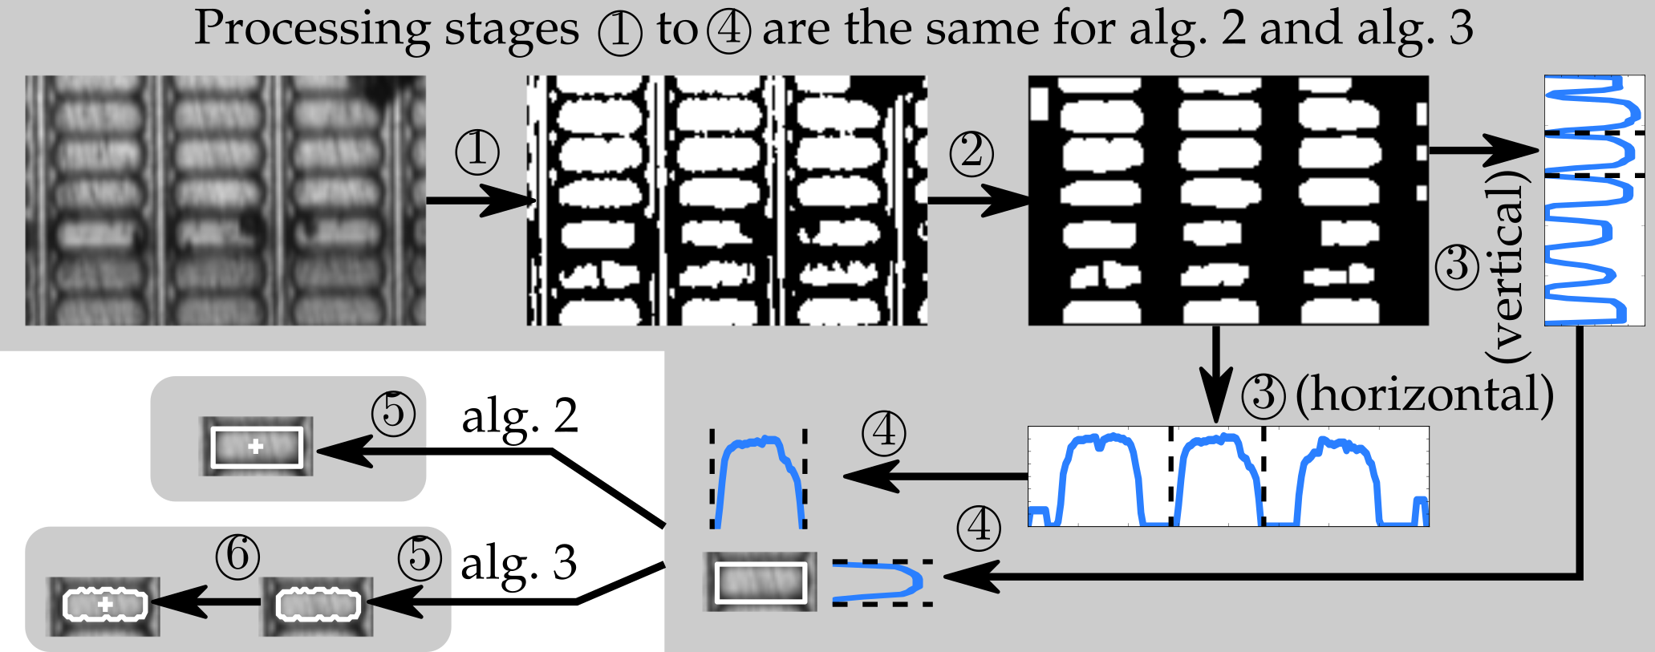
Vision Algorithms
Algorithm 1 :
Algorithm 2 & 3 :

Slide 19
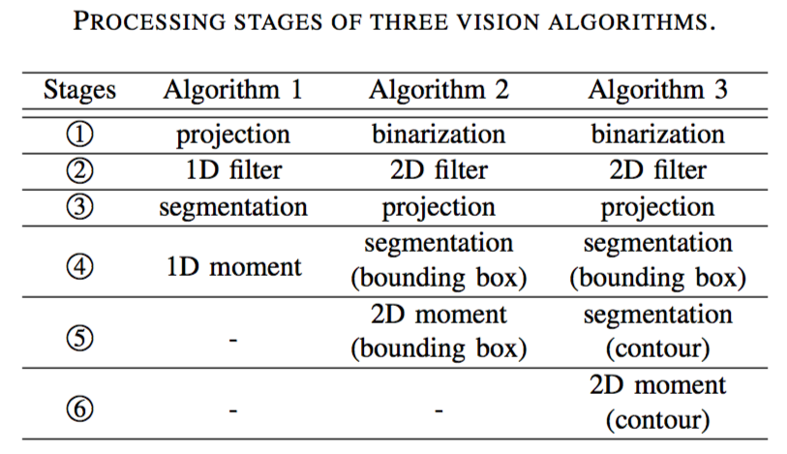
Processing Stages of Vision Algorithms

Slide 20
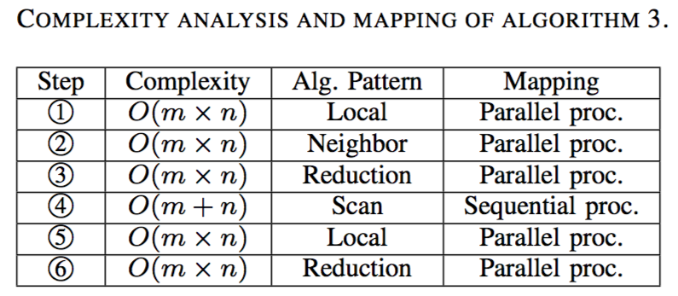
Vision Algorithm 3: Complexity Analysis

Slide 21
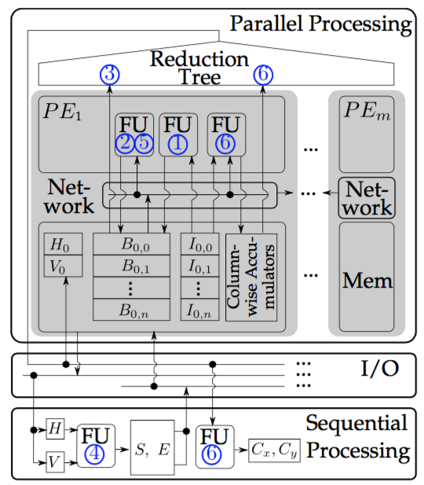
Vision Algorithm 3 on
Architecture Template

Slide 22
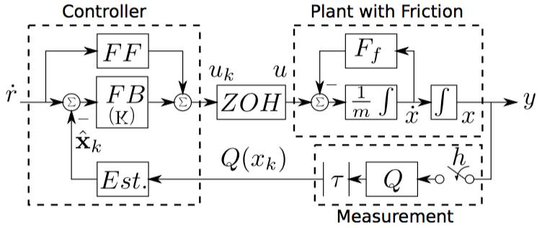
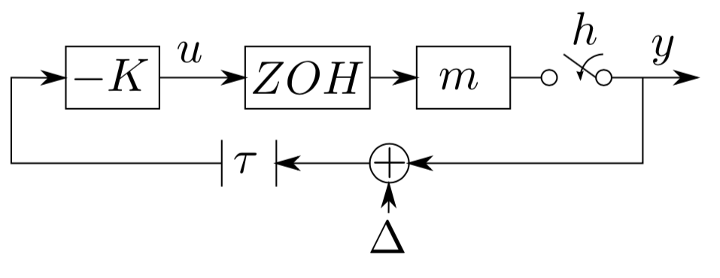
System Diagram
Simplified model for analytical methods:
quantized sampled-data system with time delay.

Slide 23
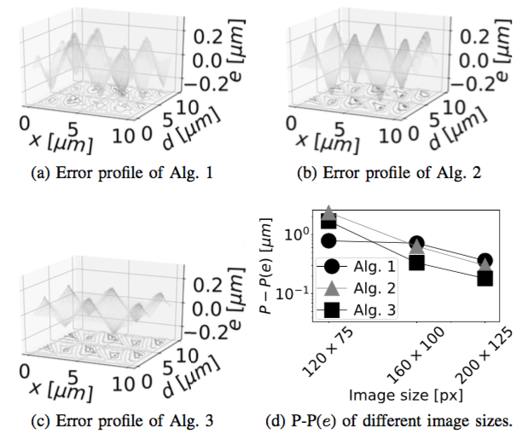

Quantization Error
    Error “e” depends on image position “x” and displacement “d”. Vision algorithms is lumped into function “g()”.

Slide 24
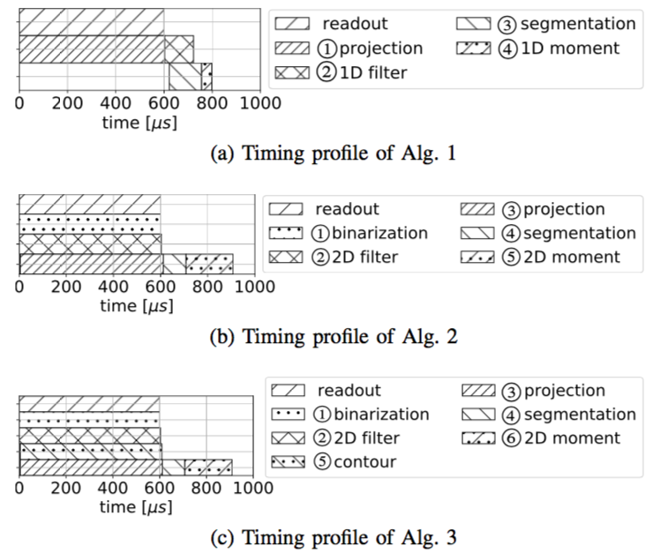
Sample Period and Delay

Slide 25
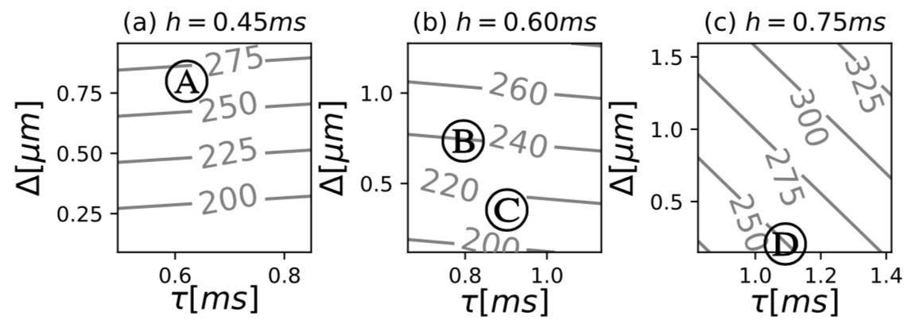
Tracking Errors of a Constant Reference

