Slide 1
Implementation, Modeling, and Exploration of Precision Visual Servo Systems
Zhenyu Ye
Dynamics and Control
Eindhoven University of Technology
Notes:
(Openning protocol) Geachte hooggeleerd promotor, thank you for your request.
I will present my thesis with the title: “implementation, modeling, and exploration of precision visual servo systems“.
First, I will explain the concept of visual servo systems, in the next slide, number 2.

Slide 2
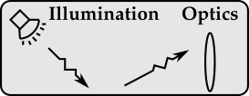
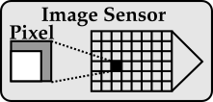
Introduction: Visual Servo Systems
Using visual feedback for control purposes.
Advantage: measurement at the point of interest.
Notes:
A visual servo system uses visual feedback for control purposes.
A visual servo system includes components from multiple domains.
It starts with an optical system that observes patterns of objects.
After that, an image sensor converts optical signals into digital images.
Then it sends digital images to the processing system that runs vision algorithms and control algorithms.
The controller then actuates the mechanical plant to perform certain motion.
A big advantage of visual feedback is that it can perform measurement at the point of interest.
However, it also comes with several challenges.
And we will look at the challenges in the next slide, slide number 3.

Slide 3
Research Challenges
Challenge 1:
Visual feedback: low sample rate, large delay, coarse quantization.
Challenge 2:
Control law design for characteristics of visual feedback.
Challenge 3:
An early estimation of delay in customized vision systems.
Challenge 4:
Cross-domain modeling and exploration of design trade-offs.
Notes:
The first challenge is that, visual feedback has a low sample rate, a large delay, and a coarse quantization.
The second challenge is that, control law needs to be designed for these characteristics of visual feedback.
The third challenge is that, it is hard to give an early estimation of the delay in customized vision systems.
The fourth challenge is that, it is hard to perform cross-domain modeling and to perform exploration of design trade-offs.
This thesis investigates into these challenges, and makes several contributions.
We start with the first challenge, in the next slide, slide number 4.

Slide 4
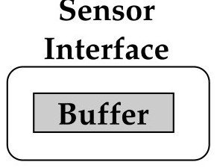
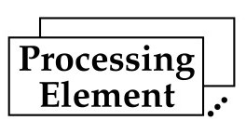
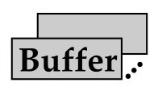
Challenge 1 and Contribution
Visual feedback: low sample rate, large delay, coarse quantization.
Contribution: design method for high-speed, high-precision vision systems.
Decouple sensor
sampling from processing
Parallel processing: increase sample rate
Pipelined processing: decouple delay and sample rate
Implementation:
Sample rate: >1khz
Delay: <2ms
Quantization: <1um
Notes:
The first challenge is that, visual feedback has a low sample rate, a large delay, and a coarse quantization.
The contribution of this thesis is in proposing design methods for high-speed and high-precision vision systems.
First, it decouples sensor sampling from processing.
After that, it uses parallel processing to increase sample rate.
In addition, it uses pipelined processing to decouple delay and sample rate.
This method is validated by an implementation.
It achieves a high sample rate of 1khz, with a delay of less than 2 milliseconds, and a quantization error of sub-micrometer.
After achieving this result, we face the next challenge, in slide number 5.

Slide 5
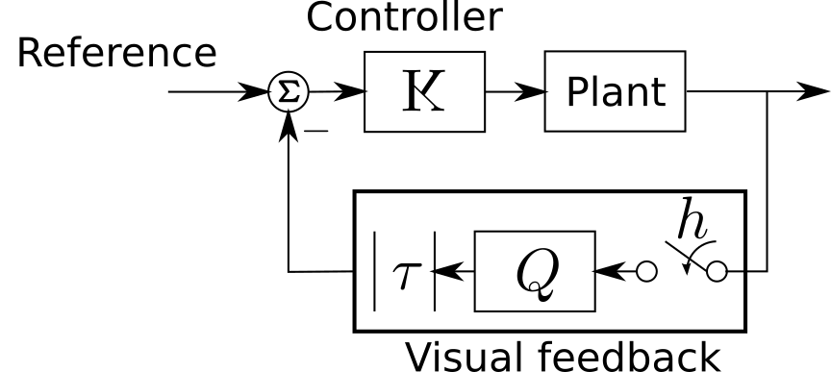
Challenge 2 and Contribution
Control law design for characteristics of visual feedback.
Contribution: controller synthesis and optimization for visual feedback.
Optimized controller gain
Delay
Quantization
Sample period
Notes:
The next challenge is that, control law needs to be designed for the characteristics of visual feedback.
The contribution of this thesis is to propose methods to perform controller synthesis and optimization for visual feedback.
Here is a high-level diagram of visual servo system.
We focus on the characteristics of visual feedback.
That is, the delay, quantization, and sample period.
Based on these inputs, the proposed method provides an optimized controller gain.
This method is demonstrated to be effective if we know all these input parameters.
However, it is hard to obtain them, especially the delay of visual feedback.
We will look at that next, in slide number 6.

Slide 6
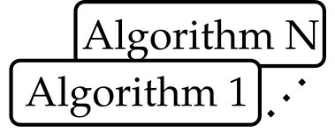
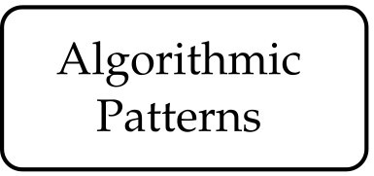
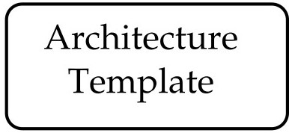
Challenge 3 and Contribution
An early estimation of delay in customized vision systems.
Contribution:
algorithmic patterns,
architecture template,
high-level synthesis.
Delay of Vision Processing
Notes:
It is a challenge to have an early estimation of delay in customized vision systems.
The contribution of this thesis is to propose a combination of methods to overcome this challenge.
First, with a large number of computer vision algorithms, we can classify them by algorithmic patterns.
Next to that, an architecture template is proposed, that can efficiently support these algorithmic patterns.
After that, high-level synthesis tool combines algorithmic patterns and architecture template.
It generates a customized vision system. We can then quickly get the delay of vision processing.
This method deals with the coupling between algorithm and processing architecture.
But there are many other couplings in the system. We will look into them in the next slide, slide number 7.

Slide 7
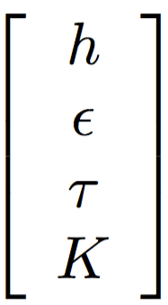
Challenge 4 and Contribution
Cross-domain modeling and exploration of design trade-offs.
Dependent
Parameters
Sample period
Quantization error
Delay
Controller gain
Notes:
Due to cross-domain couplings, it is a challenge to perform cross-domain modeling and to explore design trade-offs in visual servo systems.
Let’s look at a high-level diagram of visual servo system on the right, that we have seen earlier.
It contains a list of high level parameters, and we can put them in a vector format on the left.
These parameters are: sample period, quantization error, delay, and controller gain.
We call them dependent parameters, because they depend on the technical design of the system.
We will look into them next, in slide number 8.

Slide 8
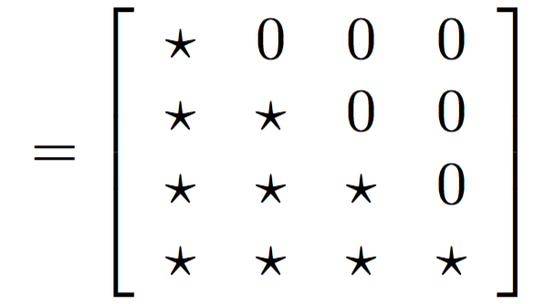
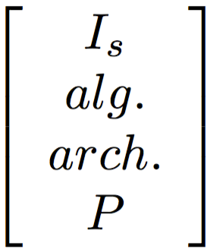
Challenge 4 and Contribution
Cross-domain modeling and exploration of design trade-offs
Contribution: cross-domain modeling using axiomatic design method.
Dependent
Parameters
Design
Matrix
Design
Parameters
: Dependence
: Independence
Sample period
Image sensor
Quantization error
Vision algorithm
Delay
Processing architecture
Controller gain
Plant
Precision
Performance criteria
Bandwidth
Notes:
On the right, we have a list of design parameters from different domains.
Such as, parameters of image sensor, vision algorithm, processing architecture, and the mechanical plant.
The challenge here is to establish a relation between the design parameters on the right and dependent parameters on the left.
The contribution of this thesis is to perform cross-domain modeling using axiomatic design method.
The axiomatic design method uses a design matrix, shown in the middle, that describes the dependency between them.
The design matrix has two types of symbols, star and zero.
The star symbol means there is dependency between them. The zero symbol means there is no dependence.
By modeling the dependencies in the matrix, we can link the parameters between left and right.
Then we go one step further. We can link these dependent parameters to the performance of the system.
Such as, precision and bandwidth.
Putting everything together, we are able to explore how the design parameters will impact the overall system performance.
We will look it further in the next slide, slide number 9.

Slide 9
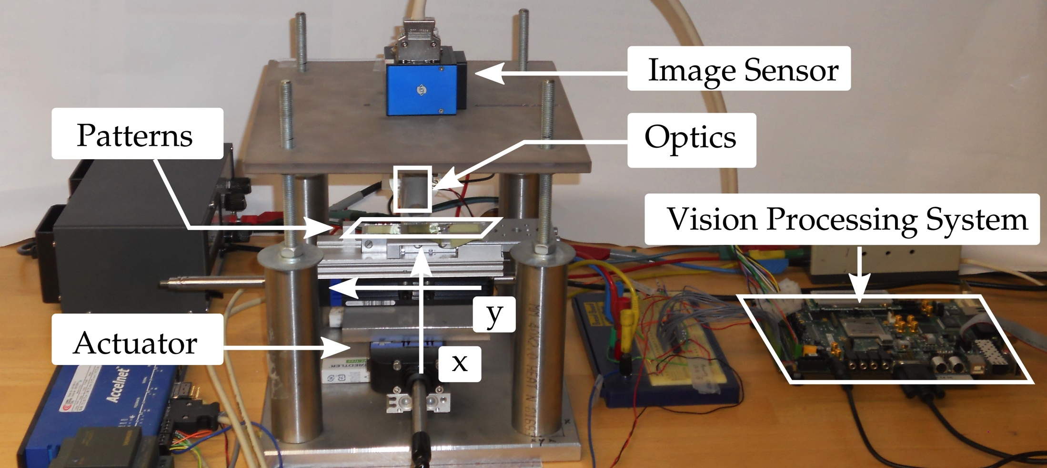
Implementation and Exploration
Implementation: validation of design methods.
Exploration: optimization of performance with cost constraint.
20% for high-precision application
43% for high-bandwidth application
Result: performance improvement
Notes:
First, a visual servo system is implemented to validate the design methods.
As we can see from the figure, it contains components from different domains.
We have seen them earlier, so I will skip the details here.
Next, based on the implementation, we explore the design trade-offs.
The exploration aims to optimize performance with cost constraints.
And the result of the exploration is that, we achieve a performance improvement of 20% and 43% for different applications.
With that, we come to the conclusions, in slide number 10.

Slide 10
Conclusions
Contributions of this thesis:
Methods to design high-speed, high-precision visual servo systems.
Methods to perform cross-domain modeling and exploration.
By implementation and case study, these methods are demonstrated to be effective.
Notes:
In conclusion, there are multiple contributions in this thesis.
First, methods are proposed to design high-speed and high-precision visual servo systems.
Next, methods are proposed to perform cross-domain modeling and optimization.
In the end, by implementation and case studies, these methods are demonstrated to be effective.
(Closing protocol) Dear promotor, I hope my presentation satisfies your request.

